Slide 1
Part database
Precision Bends Team – Anthony Rainey,
Kaleb Gwyn,
Robert Cralley
Sponsor: Zach Wilkinson

Slide 2
Project Overview
In Sprint 2, we recreated Zach’s previous app from scratch.
That app computed the blade depth (the overall goal for each step) given the parameters. It also allowed for calibrating the depth if its off the track for the goal (after 15 seconds).
In Sprint 3, we wanted to expand this functional to products:
Products are a series of steps of bends.
Sprint 2’s app worked over one bend.

Slide 3
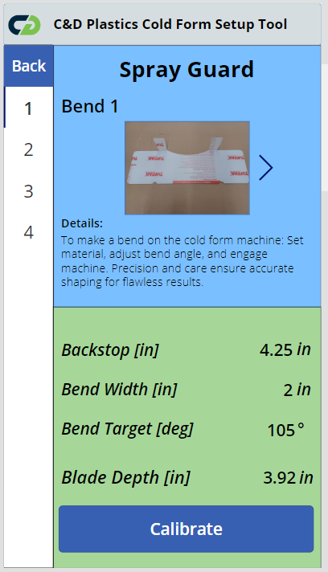
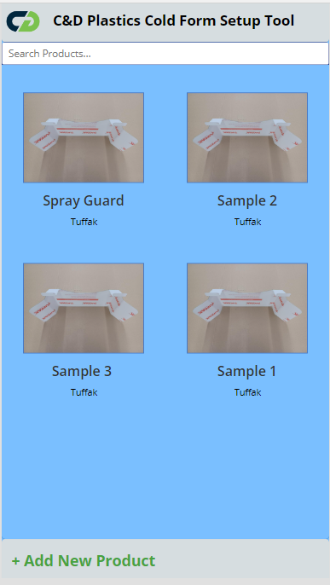
Sprint 3: Current Progress
Currently, we have created the database and pages to support products and their respective bends (steps).
Each Product is displayed on the Product Index Page.
You can search through the products by title using the search bar above.
Currently Zach has only provided one example, the other three are samples we made based off it.
By clicking on a product, you are taken to its show page.
The show page contains an introduction to the product and all the steps on the side to navigate.
Since steps can be done out of order, the sidebar was especially important to Zach.
By clicking on the bend on the left, you can see information like pictures (that you can scroll through), the description, the measurements, and the option to calibrate.

Slide 4
Demo of The App

Slide 5
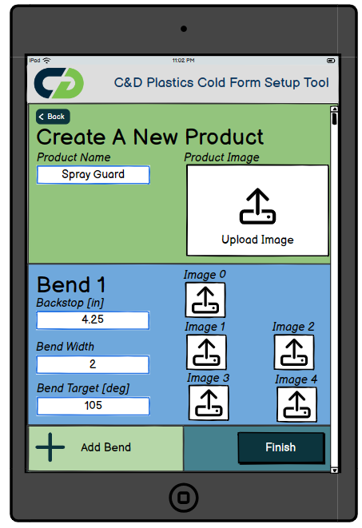
Sprint 4 GOALS
Implement a “New Product” form into the app. Zach would be able to create new products and their bends from the app.
Implement camera functional for said forms.
Create functioning calibration button (calibrates target depth based on check and measured angles).
Redesign UI aspects based on Zach’s requests.
Get more employee feedback.
Polish app.
Port app to his environment (we were working separate to not clutter his workspace).
Wireframe based on Zach’s Product Idea

